Slide 1

Online Client/Server
Android Restuaurant Application
Instructor: MIohsen D. Ghassemi, Ph.D
Team 2: Yidi Xu, Shuojia Shen, Wei Xu

Slide 2


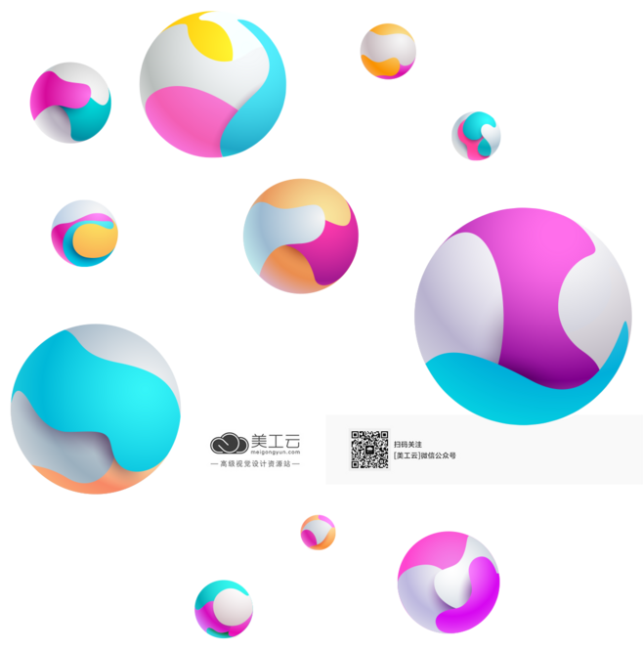

CONTENTS
01
02
03
04
Introduction
Inventory
Server
Client

Slide 3

PART.01
Introduction

Slide 4
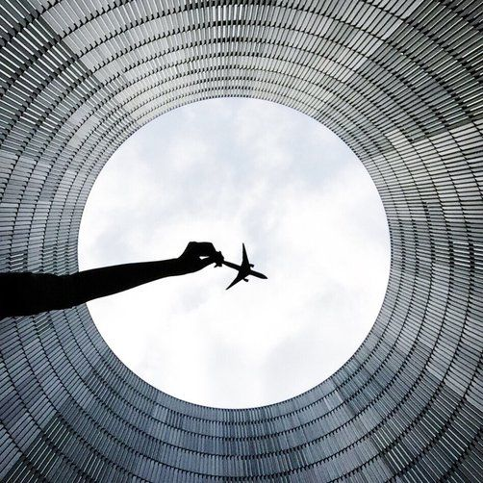
Requirements
1. Create “Inventory.txt” file with data items.
3. Design by Contract flexible design.
2. Provide UML design diagrams.
4. Develop the code for the entire application, divide the work by contract.

Slide 5
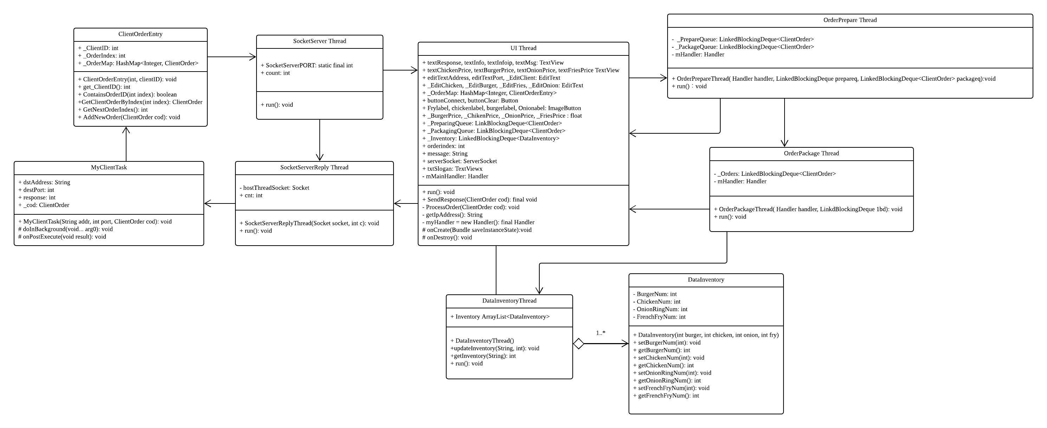
UML Class Diagram

Slide 6
PART.02
Inventory

Slide 7

DataInventory
public class DataInventory {
private int BurgerNum =0;
private int ChickenNum =0;
private int OnionRingNum =0;
private int FrenchFryNum =0;
public DataInventory(int burger, int chicken, int onion, int fry){
BurgerNum = burger;
ChickenNum = chicken;
OnionRingNum = onion;
FrenchFryNum = fry;
}

Slide 8
DataInventoryThread
public class DataInventoryThread implements Runnable {
private static final String FILENAME = "C:\\Users\\Lenovo\\Desktop\\2018Spring\\Java\\Project\\InventoryList.txt";
public static void main(String[] args) {
BufferedReader br = null;
FileReader fr = null;
List<String> InventoryList;
private LinkedBlockingDeque<DataInventory> _Inventory;
public DataInventoryThread(LinkedBlockingDeque<DataInventory> inventory){
_Inventory = inventory;
}
@Override
public void run() {
while (true) {
try {
_Inventory.clear();
for (int i = 0; i < 50; i++) {
try {......}

Slide 9
PART.03
Server

Slide 10
TECHNOLOGY OVERVIEW
DESIGN PATTERN
FLOW CHARTS

Slide 11
SOCKET
Built Socket to communicate with these two applications. In both ends, we created one socket receiver thread to receive from the sender from the other side.
DESIGN PATTERN
Producer-Consumer Pattern
Handler & Looper
JAR PACKAGE
MULTIPLE THREADS
UI Thread, Socket Server Thread, Prepare Thread, Package Thread, and Inventory Thread.
Included one Jar package in both Client and Server applications.

Slide 12
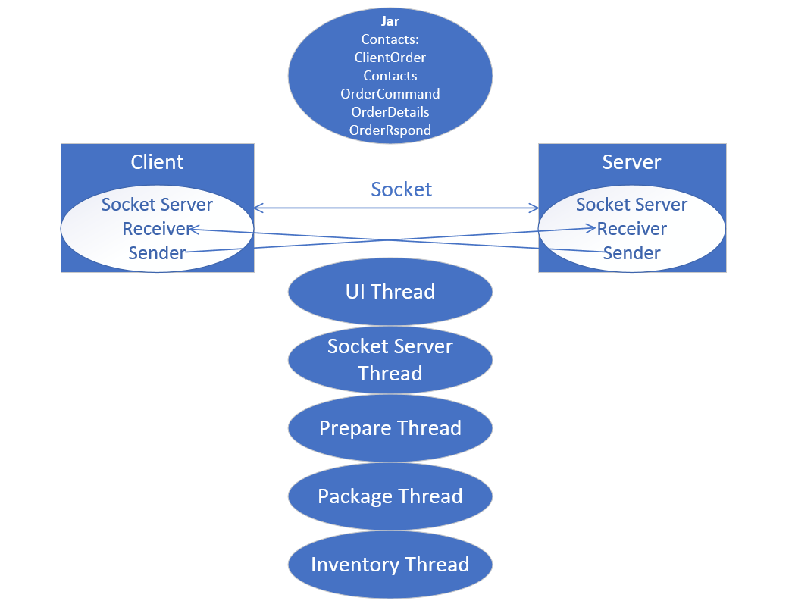
Technology Overview

Slide 13
Design Pattern
Producer – Consumer Pattern
The Producer Consumer pattern contains two major components, which are usually linked by a queue.
2. Handler & Looper
Handler enqueuers task in the MessageQueue using Looper and also executes them when the task comes out of the MessageQueue.

Slide 14
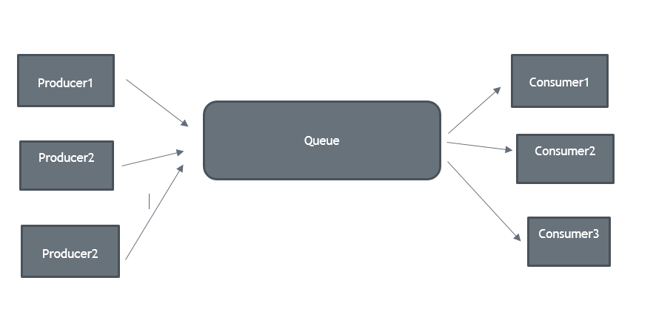
Design Pattern
1.Producer-Consumer Pattern
The Producer Consumer pattern is an ideal way of
separating work that needs to be done from the execution of that work.
All they need to do is to grab some work from the
queue and process it.
We used LinkedBlockingQueue to achieve the goal.
Image source: stackoverflow.com

Slide 15
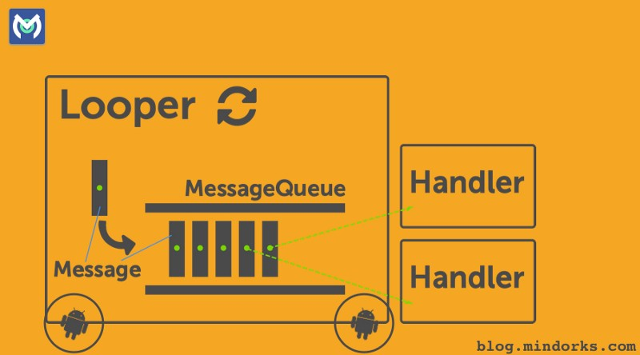
Design Pattern
2. Handler and Looper
MessageQueue is a queue that has tasks called messages which should be processed.
Handler enqueuers task in the MessageQueue using Looper and also executes them when the task comes out of the MessageQueue.
Looper is a worker that keeps a thread alive, loops through MessageQueue and sends messages to the corresponding handler to process.
Image source: blog.mindorks.com

Slide 16
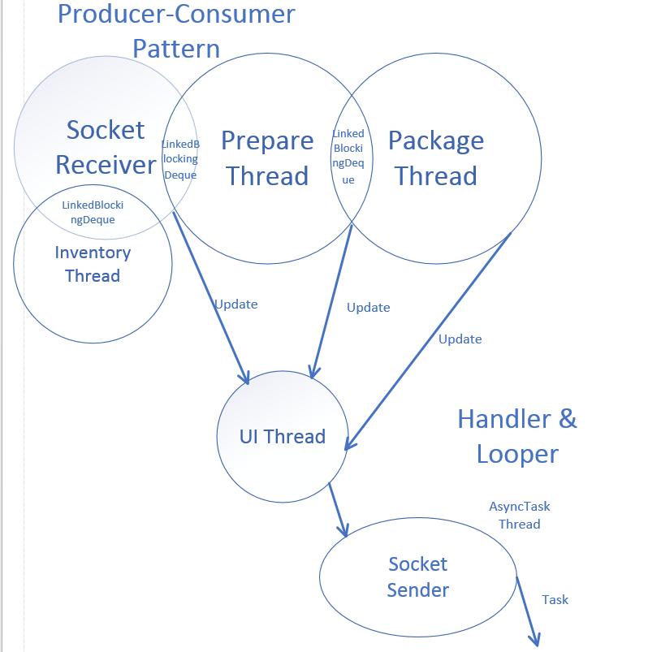
Deign Pattern

Slide 17
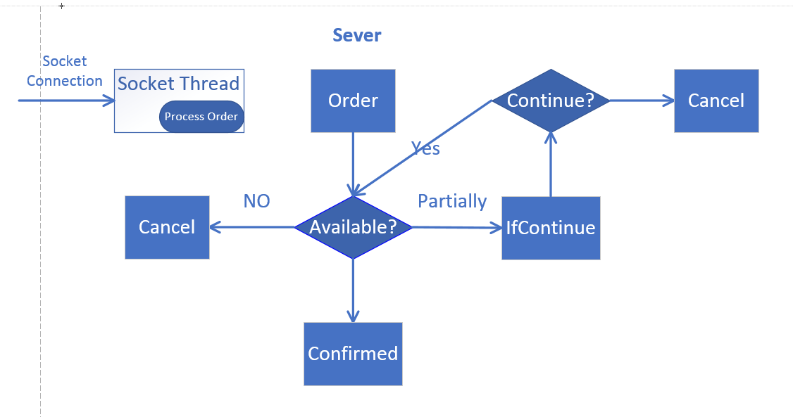
Flow Charts

Slide 18
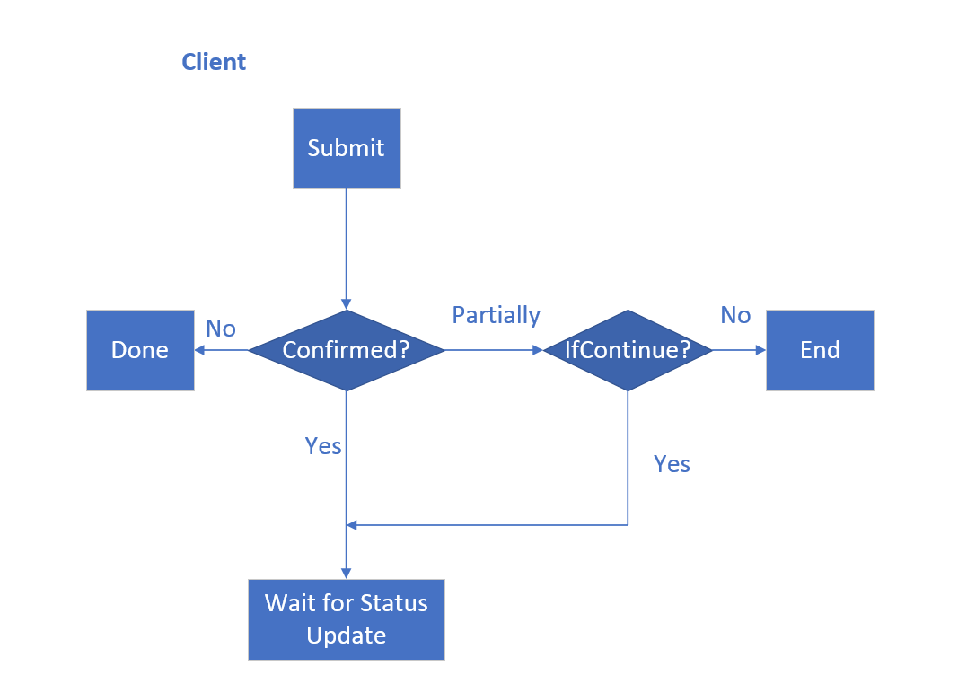
Flow Charts

Slide 19
PART.04
Client

Slide 20
What should we do
MENU LIST
FOOD DETAIL
SUBMIT ORDER
TO SERVER PART
Waiting for conformation or notification
Give response back to server
Status update

Slide 21
Function we need …
User Interface. (Intent)
Connect client and server. (socked thread)
Generate Oder list.(HashMap and Contacts.jar)
Send Order to server end and waiting for response.

Slide 22
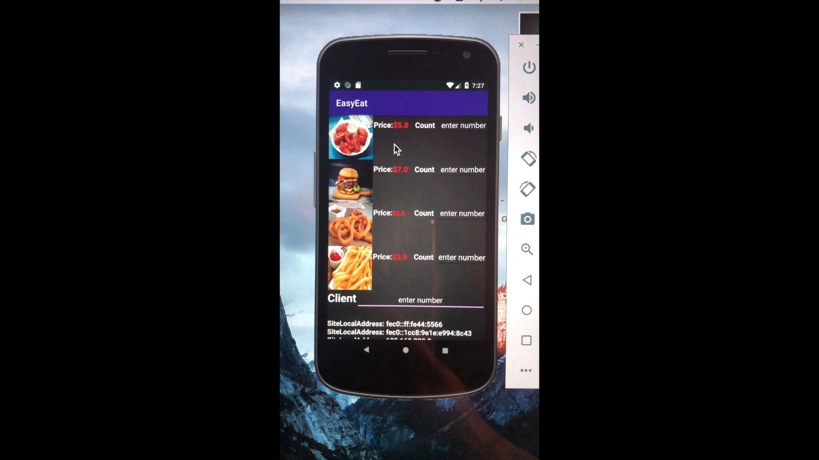
Screen Shot 2018-04-17 at 9.01.27 PM
Screen Shot 2018-04-17 at 9.01.34 PM
Click the picture to see the food details
burgerlabel =(ImageButton)findViewById(R.id.burgerlabel);
burgerlabel.setOnClickListener(new OnClickListener() { @Override public void onClick(View view) { Intent burger = new Intent(Main3Activity.this, Burger.class); startActivity(burger); } });

Slide 23
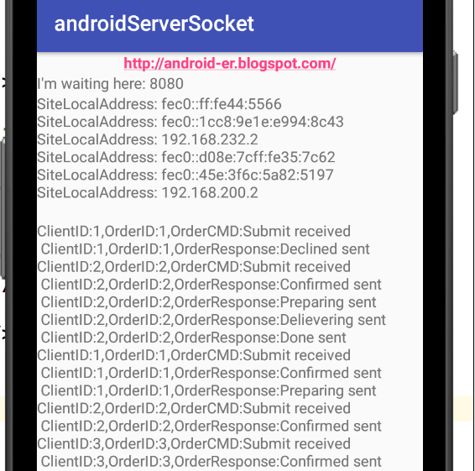
Realize the communication between server & client
Thread socketServerThread = new Thread(new SocketServerThread()); socketServerThread.start();
getIpAddress (); SocketServerPORT

Slide 24
Receive notification from server then update order
SocketServerReplyThread(Socket socket, int c)
OutputStream outputStream;
PrintStream printStream = new PrintStream(outputStream);
final AlertDialog.Builder alertDialogBuilder = new AlertDialog.Builder(this);
[Cancel or Continue]

Slide 25
Placed order then generate order list
Socket socket = serverSocket.accept();
Contracts. Jar
ObjectInputStream ois = new ObjectInputStream(socket.getInputStream());
HashMap<Integer, ClientOrder> _OrderMap; _OrderMap = new HashMap<Integer, ClientOrder>();

Slide 26
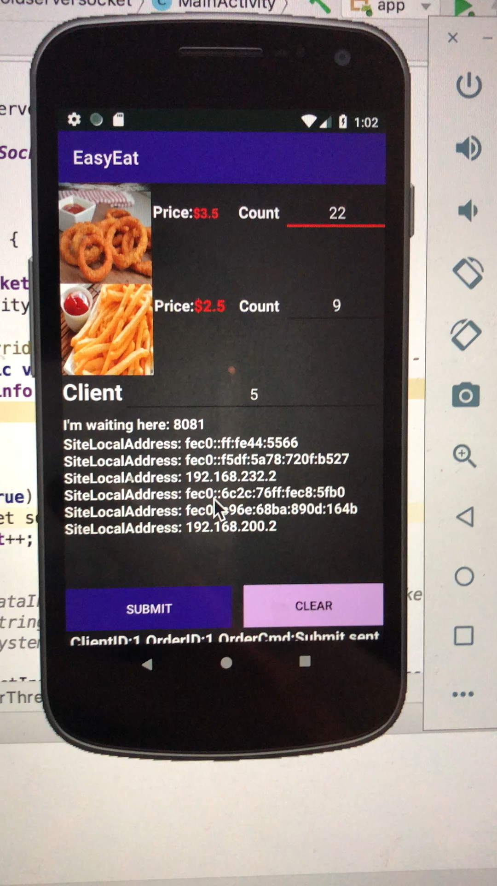
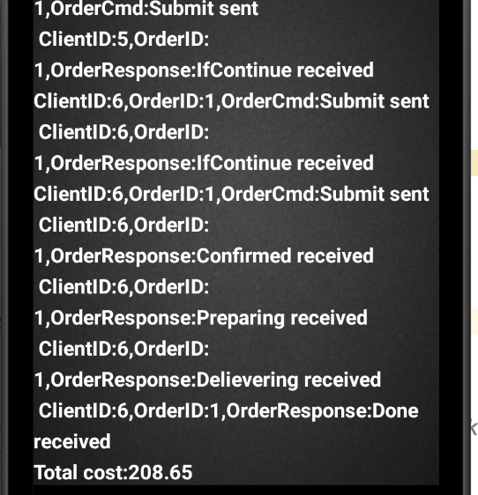
Notification & confirm

Slide 27
Quickly look through whole project
https://www.youtube.com/watch?v=8kTuyz-yPwo

Slide 28
Thanks !

